Slide 1
OpenCV & Face Recognition
Almas Myrzatay

Slide 2
Outline
OpenCV
Demo
Face Recognition: Overview of the process
Existing state-of-the art Face Recognition techniques
Demo
Drawbacks
My research
Q & A
Bibliography

Slide 3
Opencv: What can you do?
Read and write images
Detection of faces and its features.
Detection of shapes like Circle,rectangle etc in a image. E.g Detection of coin in images.
Text recognition in images. e.g Reading Number Plates/
Modifying image quality and colors e.g Instagram, CamScanner.
Developing Augmented reality apps
OpenCV (Open Source Computer Vision) is a library of programming functions mainly aimed at real-time computer vision

Slide 4
Demo
Drawing.py
Thresholding.py
ColorFiltering.py

Slide 5
Neural networks

Slide 6
Face Recognition: Process

Slide 7
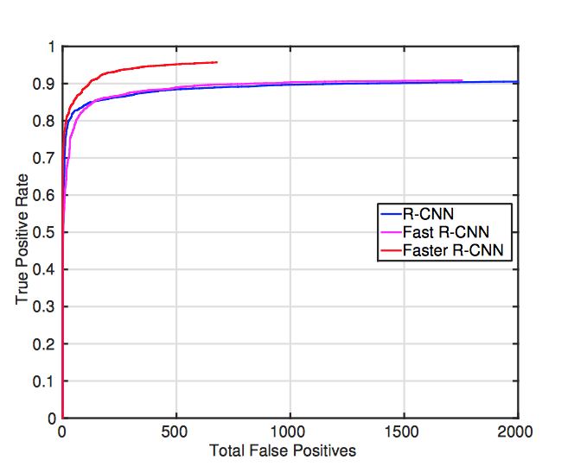
Face recognition: State of the art techniques
3 Generations of region-based CNN
Regional Convolution Neural Network (R-CNN)
Fast R-CNN
Faster R-CNN

Slide 8
Demo

Slide 9

Challenges of object recognition
Variation of view points
Lighting/illumination
Hidden parts of images
Image and background blending

Slide 10
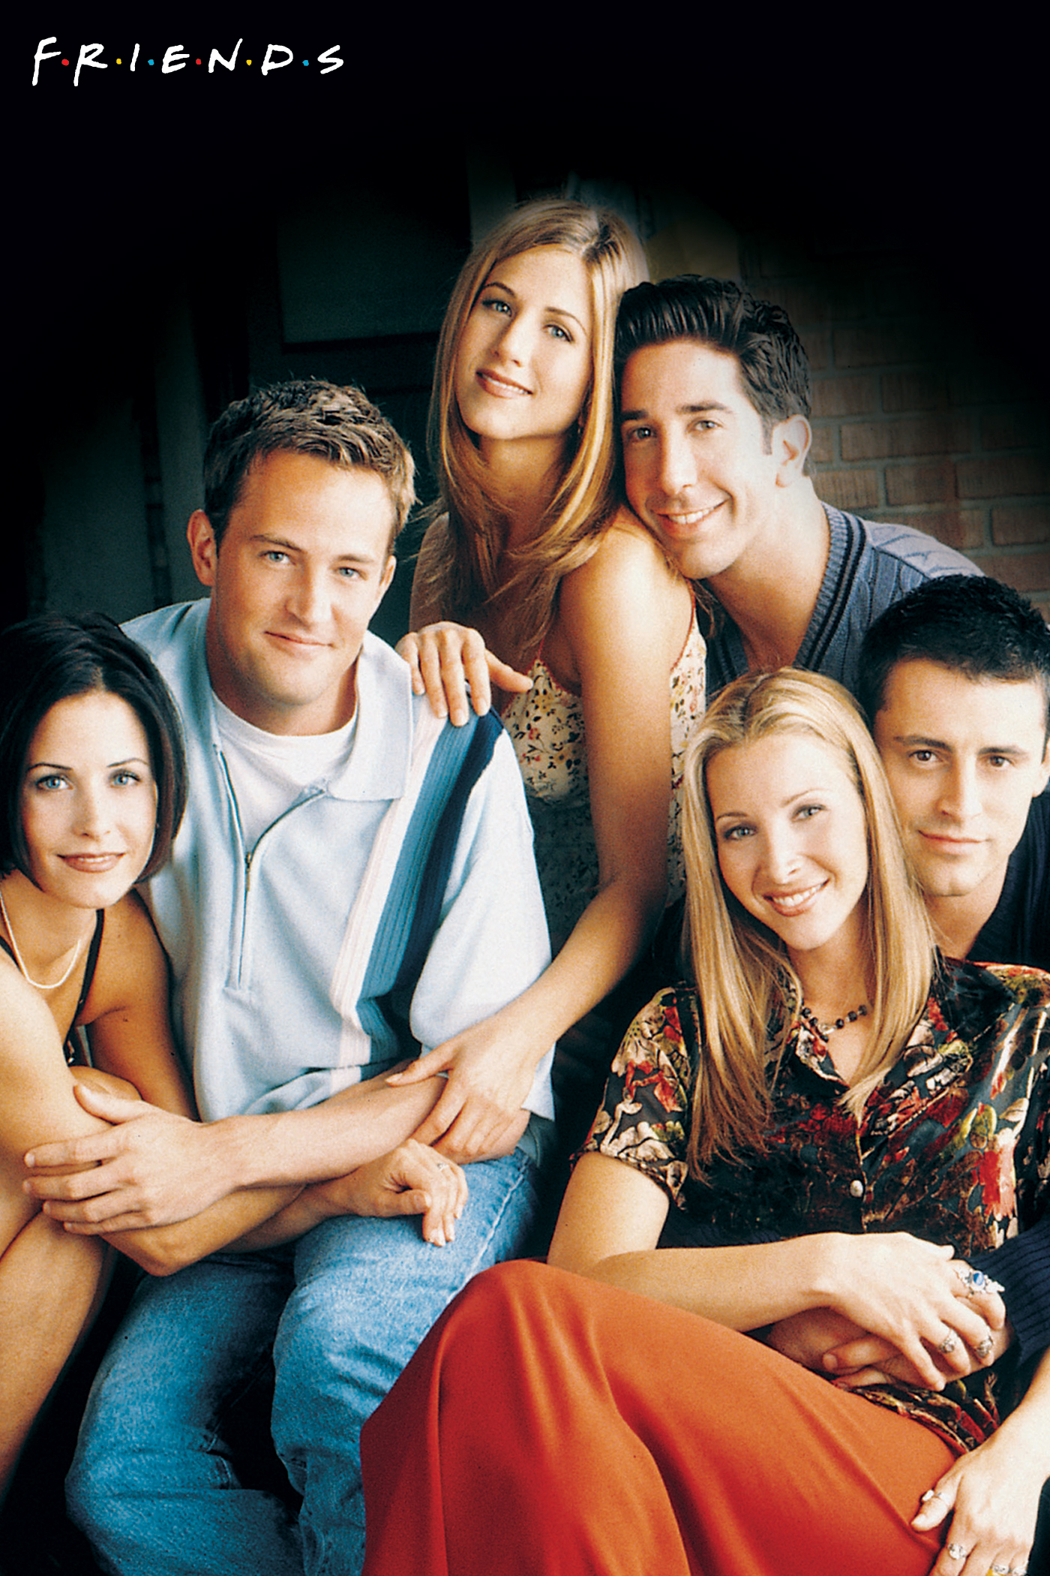
My research: Emotion detection
Friends TV show
Subtitles and transcript match
Recognize characters in the TV show

Slide 11
Bibliography
https://en.wikipedia.org/wiki/OpenCV
https://www.quora.com/What-is-openCV
https://cmusatyalab.github.io/openface/
https://www.youtube.com/user/sentdex/playlists
https://github.com/rragundez/PyData
https://www.analyticsvidhya.com/blog/2016/04/deep-learning-computer-vision-introduction-convolution-neural-networks/
https://arxiv.org/pdf/1606.03473v1.pdf

